Slide 1

MultiBatch 10
MultiBatch 10 Release | November 2022

Slide 2
What is MultiBatch?
MultiBatch is a workload automation tool built specifically to make best use of NonStop scalability and fault tolerance.
MultiBatch 10 Release | November 2022

Slide 3

What do you get with MultiBatch?
  Tasks driven by time, dependency or manually
  Guardian and OSS processes fully and equally supported
  Built in disaster recovery
  Facilitates task parallel processing
  Central Deployment across network to your environments
  Deeply parametised to better manage very large schedules
  One time definition of assigns, defines, params, FDs and environment variables
  Optional user task to MultiBatch message protocol to give easy fault tolerance
  Simple macro driven installation with easy-to-follow installation guide
  A comprehensive and detailed technical guide provided to explain all above concepts and usage
MultiBatch 10 Release | November 2022

Slide 4
What more do you get with MultiBatch 10?
  Introduction of Define Classes, these allow sets of defines to be configured once and then linked to any number of steps
  Many limits have been increased; a single BMON can now control 2500 job
  Introduction of On Demand Jobs, you can now define Model Jobs; these can be cloned at the command line and then modified and run as required
  Support for OSS processes has been reworked and improved
  Conditional Parameter values can now be up to 100 characters
  Both Conditional Parameter and Event Timer processing is now fully incorporated in the MultiBatch 10 menu, security and auditing functionality
MultiBatch 10 Release | November 2022

Slide 5
How does MultiBatch 10 compare vs NetBatch?
 | MultiBatch | NetBatch and Netbatch+
Network Capable | Yes, centrally managed | Yes, centrally managed
Job Process Control | Direct, all under monitor control | Executor Scripts start multiple processes
Job Dependency Control | Monitor controlled dependency | Executor Scripts release dependent jobs
Job Parameters | Assigns, Defines, Params, FDs and Environment | Assigns, Defines, Params
Job Selection | Direct, run when scheduled | Class controls access to Executor and then CPU
Job Structure | JOB, SEGMENT, UNIT to facilitate parallel processing | Controlled by user written Executor script
Scheduling Options | Time, Interval, Calendar, Dependency, CRON | Time, Interval, Calendar, Dependency, Delay, CRON
Migration | Deep migration of complete schedule with translation | Simple migration with manual script updates
Parameterisation | Granular field level | Job Default Sets
Disaster Recovery | Inbuilt monitor recovery | No
OSS Support | Yes | No
Status Monitor | Comprehensive multi-level dynamic subsystem | Single Screen
Monitor to Process Protocol | Yes, to report progress and for restart | No
Start Time Monitor | Yes | No
MultiBatch 10 Release | November 2022
Notes:
MultiBatch provides significantly more sophisticated and integrated job definition. Not needing to write scripts external from the database job definition is a major benefit when managing a batch environment.
MultiBatch has deep support for OSS processes. Specific support is included in the user interface and scheduler equivalent to that for Guardian processes.
MultiBatch manages all job dependency logic centrally in the scheduler. There is no requirement to write specific job release logic. Job dependencies are automatically adjusted depending on the job set to be run.
MultiBatch provides a significantly more complete and comprehensive view of job schedule status.
MultiBatch has an active roadmap where new features are designed, planned and scheduled for release. Customers have input to the roadmap.

Slide 6
MultiBatch beats NetBatch across the board.
  MultiBatch 10 provides significantly more sophisticated and integrated job definition. Not needing to write scripts external from the database job definition is a major benefit when managing a batch environment.
  MultiBatch 10 has deep support for OSS processes. Specific support is included in the user interface and scheduler equivalent to that for Guardian processes.
  MultiBatch 10 manages all job dependency logic centrally in the scheduler. There is no requirement to write specific job release logic. Job dependencies are automatically adjusted depending on the job set to be run.
  MultiBatch 10 provides a significantly more complete and comprehensive view of job schedule status.
  MultiBatch 10 has an active roadmap where new features are designed, planned and scheduled for release. The roadmap is determined by our customers.
MultiBatch 10 Release | November 2022

Slide 7
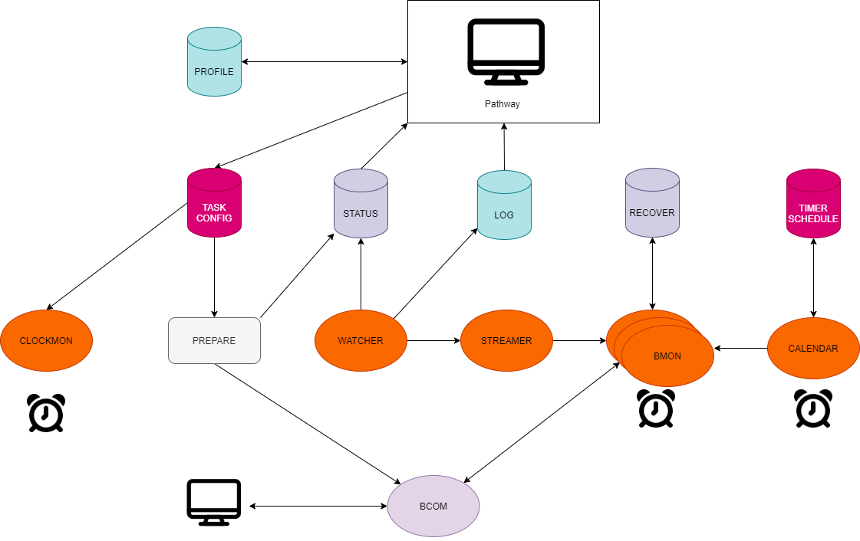
MultiBatch Architecture.
MultiBatch 10 Release | November 2022

Slide 8
What do I need to run MultiBatch 10?
SYSTEM REQUIREMENTS
HPE NonStop system running under L19.03, J06.22 or later versions
SOFTWARE REQUIREMENTS
MultiBatch requires the following products.
On L-series OS
SKU | Description
BE359AC | HPE NonStop TS/MP (ACS)
BE221AC | HPE NonStop COBOL85 Run Time Library
On J-series OS
SKU | Description
QSR78 | HPE NonStop TS/MP (ACS)
QSB81 | HPE NonStop COBOL85 Run Time Library
MultiBatch 10 Release | November 2022
Notes:
Software:
Code 100 Objects
COBOL and TAL Pathway Servers
TAL Process Pairs
COBOL and TAL Housekeeping Programs
Enscribe TMF Audited Database
TACL Installation Macros
Code 500 and 800 Interface Libraries
C function for encrypting/decrypting licence key
Code 101 Edit Licence File

Slide 9
Installation and configuration.
  Comprehensive installation guide provided
  Two PAK files, one contains install Macro and the other the database and programs
  A third PAK file contains the licence files
  Define a user group and member of the group that the software will run under and who will install the software
  Additional users will be required to own elements and maintain the configuration
  Decide on the volume where the software is to be installed and UNPAK the installation macro
  Simple menu driven process to install software
  Defaults can usually be accepted and the process is complete in a few minutes
  Two executables execute privileged code to change user id, these must be licensed
MultiBatch 10 Release | November 2022

Slide 10
Pathway SCOBOL environment.
  70+ Screens
  Logon using standard Guardian User
  Main sections are security, configuration, status monitoring and event timer
  Map of screens and comprehensive description provided in the Technical Guide
  Standard function keys for navigation and screen processing
  Online help via F16
  Navigate using mnemonic via F14
  List of functions via F13
  Previous Screen F15 | Back to menu SF15
  Current screen function key list scrolled using SF13
  Deletes require confirmation F3 followed by SF4
MultiBatch 10 Release | November 2022

Slide 11
Access control and security.
  Licence File
    Contains details of the nodes and CPU configuration applicable to the site
  Pathway
    22 facilities for different areas of functionality can have user access control
    A security class defines a set of Y/N access to the facilities
    A user can be allocated any number of security classes
    Some of the classes additionally require ‘Owner’ access
  BCOM
    Related to values set on BMON Config(CBM) screen
    Two flags (config and other) take file security value O-owner, G-group, A-any
    A privileged user who can do privileged tasks like changing status flags
MultiBatch 10 Release | November 2022

Slide 12
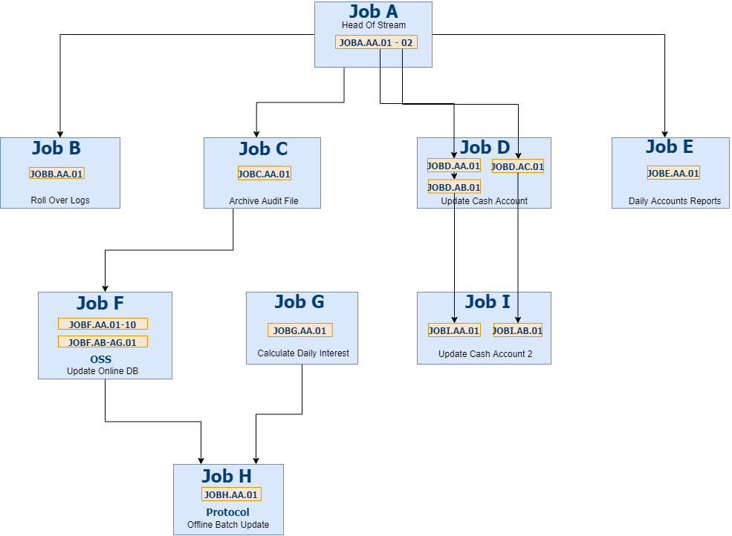
Our test schedule.
MultiBatch 10 Release | November 2022
Notes:
JOB 4 Chars
SEGMENT 2 Chars
UNIT 2 Chars
STEP 1 Chars
For example JOBA.AA.01.1
Units can be 1 or 2 Step
Segment to segment dependencies
Multiple Units facilitate key range parallel processing
Alias names are used to give more meaningful names

Slide 13
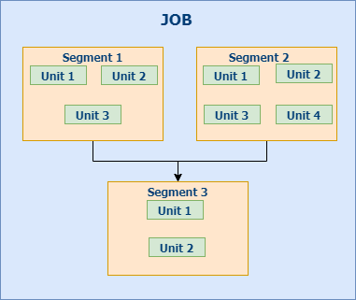
Unique Job structure.
MultiBatch 10 Release | November 2022
Notes:
JOB 4 Chars
SEGMENT 2 Chars
UNIT 2 Chars
STEP 1 Chars
For example JOBA.AA.01.1
Units can be 1 or 2 Step
Segment to segment dependencies
Multiple Units facilitate key range parallel processing
Alias names are used to give more meaningful names

Slide 14
Task set-up.
  Configure BMON (CBM)
  Configure JOB (CJB)
  Configure SEGMENT (CSE)
  Configure UNIT Guardian (CST)
  Configure UNIT OSS (COS)
  Prepare Phase (PRM)
  Start BMON and parse BCOM command file
  Configure Defines
  Assign Classes
  Define Classes
  Param Classes
  FD Class
  ENV Class
  Start-time Monitoring
MultiBatch 10 Release | November 2022

Slide 15
Scheduling.
  Job start time
  At Job, Segment, and Unit level:
    Absolute: for example, a WEEKEND, TUESDAY and TODAY can be included or excluded
    Frequency, for ad hoc jobs
    Calendar, can be included or excluded
  Prepare phase select jobs to run based in scheduling
MultiBatch 10 Release | November 2022
Notes:
Job Start Time
On the CJB screen
Prepare Phase
Is run for each BMON
Prepares a BMON schedule of:
Jobs (J), Segments (S), Units (U)
Determines dependencies
Creates two disk files:
Loadlist & Build
Loadlist
Mandatory field in PRC screen
Lists Jobs, Segments & Units scheduled to run
Displays dependencies & re-worked dependencies
Displays J, S, U not scheduled to run
Build File
Mandatory field
Provides actual BCOM commands to Build process to build a BMON
Job Start Time
On the CJB screen
Prepare Phase
Is run for each BMON
Prepares a BMON schedule of:
Jobs (J), Segments (S), Units (U)
Determines dependencies
Creates two disk files:
Loadlist & Build
Loadlist
Mandatory field in PRC screen
Lists Jobs, Segments & Units scheduled to run
Displays dependencies & re-worked dependencies
Displays J, S, U not scheduled to run
Build File
Mandatory field
Provides actual BCOM commands to Build process to build a BMON

Slide 16
Status monitoring
  Separate status database initialized by prepare
  Updated by Watcher
  Status Menu (SOM)
  Dynamic display facilitated unsolicited messages to TCP from Watcher
  From Status DB
    Status Overview (SOV)
    Status Job (SJB)
    Status Segment (SSG)
    Status Unit (SUN)
  Directly to BMON
    Current Status (SOC)
    BCOM STATUS JOB/SEGMENT/UNIT
    Status Unit (SUN)
MultiBatch 10 Release | November 2022

Slide 17
Event timer.
  Job start time
  At Job, Segment, and Unit level:
    Absolute: for example, a WEEKEND, TUESDAY and TODAY can be included or excluded
    Frequency, for ad hoc jobs
    Calendar, can be included or excluded
  Prepare phase select jobs to run based on scheduling
MultiBatch 10 Release | November 2022

Slide 18
BMON protocol.
  BMON supports a set of messages that allows the process associated with a step to communicate with it to store the unit’s status.
  BMON Protocol provides a tight integration between a user program and BMON where:
    specific bits in the step status flags are utilised, these provide extra status information for the unit
    the process itself can define and report when it is complete
    the process can take advantage of BMON’s fault tolerance to log progress by reporting its status, on restart it can retrieve the last logged status
    when requesting status details using BCOM the extra details are provided.
    The communication is via standard inter-process communication and requires the step process to open BMON. BMON will be the process’s creator and the process id to be opened can be obtained using the MOM procedure.
MultiBatch 10 Release | November 2022

Slide 19
Conditional parameters.
  Allows substitution of delimited values, for example <DISC> could equate to $DATA1
  Param value relationship at “local”, usually BMON level, and “global” where “local” is optionally overridden
  Substitution is within BCOM when commands are parsed and params are substituted before they are processed
  Guardian and OSS Configuration screen support “explaining” what the value will be (SF11)
  The local “shell” identifier, usually the BMON process name, is defined on CBM and CST
  Possible to change “<” and “>” for another single character on CST
MultiBatch 10 Release | November 2022

Slide 20
Migration program
  Migrator executable provided with MultiBatch
  Relocates data between MultiBatch environment
  Complete or partial schedules can be relocated
  Environments can be:
    Extracted (copy taken)
    Inserted
    Removed (deleted from database)
  A “Transit” file provides the means to move data between databases
MultiBatch 10 Release | November 2022

Slide 21
Logging.
  Audit Log of Screen Actions
    List Audit Log(ALL)
    List by user, terminal or timestamp
  Error Log
    List Error Log(ERL)
    Error are detected by BMON and raised as events, the watcher
MultiBatch 10 Release | November 2022

Slide 22
Disaster recovery.
  BMON maintains an audited recovery file
  All changes to job status are written
  In DR you can recover your schedule with just two commands
    Define the new recovery file
    Sync In the old recovery file
  Node, Volumes, Sub-volumes and Directories can be mapped to DR site config
MultiBatch 10 Release | November 2022

Slide 23
Interface libraries.
  MultiBatch 10 is shipped with two libraries:
    LIBUTIL - enabling user applications to communicate with BMON to HOLD, RELEASE, START, RESTART or ABORT Jobs, Segments and Units
    ETIMLIB – for “AT” schedule, enables retrieval and amended of next run and status
    Comprehensive description in the Technical Guide
    Code 100, 500 and 800 objects
    COBOL source code examples provided
MultiBatch 10 Release | November 2022

Slide 24
Enterprises are facing their biggest challenge.
  Trying to bring together huge amounts of disparate information, from multiple platforms and data streams, and compiling them into processes that can be run with as little human intervention – and therefore, less risk – as possible
  Gartner calls this Hyperautomation
  It’s more commonly known as Workload Automation
  HPE NonStop MultiBatch increases efficiencies, reduces risk and lowers the overhead cost of scheduling business critical workloads in complex environments
MultiBatch 10 Release | November 2022
Notes:
In a world that is moving away from rigid timetables on single platforms into anytime flexible scheduling of complex business processes across multiple applications and platforms Enterprise clients need reliable tools to stay in control.
Asking your skilled workers to monitor, support and maintain this environment is a big ask without the right tools.
MultiBatch 10 provides an open environment with dynamic oversight and control that allow you to unleash your customer’s NonStop X investment.

Slide 25
What is workload automation?
  Workload automation (WLA) is the process of using software to schedule, initiate and execute business processes, transactions, workflows or other related tasks
  The use of workload automation allows for all of this processing to happen without human or manual intervention
  Unlike other systems of automation, workload automation is less focused on time-based processing and more focused on real-time processing, predefined event-driven triggers and situational dependencies
MultiBatch 10 Release | November 2022
Notes:
Workload automation (WLA) is the process of using software to schedule, initiate and execute business processes, transactions, workflows or other related tasks.
The use of workload automation allows for all of this processing to happen without human or manual intervention
Unlike other systems of automation, workload automation is less focused on time-based processing and more focused on real-time processing, predefined event-driven triggers and situational dependencies

Slide 26
Introducing MultiBatch 10.
  MultiBatch 10 is the only Workload Automation manager specifically designed for NonStop that is actively developed around Continuous Innovation principles
  It provides high-performance parallel processing combined with advanced operational control across your NonStop nodes from within a single interface
  MultiBatch delivers the enterprise-class capability for NonStop users with serious workload requirements
  Compared to NetBatch, MultiBatch is more customizable and has the benefit of continuous investment in development
MultiBatch 10 Release | November 2022
Notes:
MultiBatch 10 is the only Workload Automation manager specifically designed for NonStop that is actively developed around Continuous Innovation principles.
It provides high-performance parallel processing combined with advanced operational control across your NonStop nodes from within a single interface.
MultiBatch delivers the enterprise-class capability for NonStop users with serious workload requirements.
It can be compared with NetBatch but is more customizable and has the benefit of continuous investment in development. We’ll explore some of the competitors to MultiBatch towards the end of the presentation.

Slide 27
What makes MultiBatch 10 different?
  Prescriptive approach
  Simplification
  Validation
  Pathway interface
  DR
  Easy adoption
  Security
  Real-time monitoring
MultiBatch 10 Release | November 2022
Notes:
In today’s presentation, we’ll focus on the following aspects of MultiBatch.
Prescriptive Approach - the unique design of MultiBatch
Simplification – automatically migrate configurations between environments
Validation – how MultiBatch ensures that the correct job runs every time
Pathway Interface - build manage and maintain complex schedules with ease
DR – the power of MultiBatch’s built in disaster recovery
Easy Adoption - no TACL programming skills required
Security – the built in security that comes with MultiBatch
Real-Time Status Monitoring – our single pane of glass that gives you real-time info
At the end of the slides we’ll run through any specific questions, including those that were highlighted in the PointNext training

Slide 28
Prescriptive approach.
  Instant reaction to schedules (a job starts exactly when and where you tell it to)
  Jobs will never queue
  No inconsistency, no variables. No temperamental behavior
  Designing workload schedules is simpler. Design flows directly
  Point jobs at the desired and planned CPU, removing any ambiguity of where jobs are running
  Highly predicative because processes run in the same CPU every time
MultiBatch 10 Release | November 2022
Notes:
In complex environments, a prescriptive approach is better. Companies have invested the time to analyse and design the best optimal process. The expectation is for the schedule to carry out exactly what it was designed to do. Random operations add an element of unpredictability. Consistent and repeatable.
Instant reaction to schedules (a job starts exactly when and where you tell it to)
Jobs will never queue
No inconsistency, no variables. No temperamental behavior
Designing a schedule is simpler. Design flows directly
Point jobs at the desired and planned CPU, removing any ambiguity of where jobs are running
Scheduling optimization; if a job uses too much CPU on a day you can amend the Measure data
Highly predicative because processes run in the same CPU every time

Slide 29
Simplification.
  There are no manual changes to be made, therefore risk is massively reduced
  Simplifies the Change / Release process
  A single file is used to migrate a schedule
  Changes made on a TEST node can be migrated to PRODUCT node with zero config modifications
  Better auditability – meets local and regional requirements.
  The schedule is compressed into a single, portable file with is totally self contained
  No need to copy TACL scripts, calendar files, etc or other supporting files to new environments
MultiBatch 10 Release | November 2022
Notes:
Customers require multiple environments (e.g. TEST, TRIAL, PRODUCTION, DR). Schedules need to move between the environments with maximum portability and safety. MultiBatch’s Migrator removes the need for manual changes. Automatically migrate configurations between environments.
There are no manual changes to be made, therefore risk is massively reduced
Simplifies the Change / Release process
A single file is used to migrate a schedule
Changes made on a TEST node can be migrated to PRODUCT node with zero config modifications
Better auditability – meets auditor requirements which is becoming increasingly high on a CTO or IT Director’s agenda
The schedule is compressed into a single, portable file with is totally self contained
No need to copy TACL scripts, calendar files, etc or other supporting files to new environments

Slide 30
Validation.
  Instant reaction to schedules (a job starts exactly when and where you tell it to)
  Be confident and avoid costly mistakes by validating a schedule before it runs
  Get a pre-flight check to meet scheduling requirement
  Empower a new generation of NonStop users
  CheckStart in MultiBatch validates sequencing (especially useful when restarting a failed program
  Prepare facility provides Include / Exclude processing. A job that shouldn’t run, can’t, as it’s not loaded
  Prepare facility allows schedule checking for advance dates
  Increase customer satisfaction by ensuring regularity and meeting SLA’s
  Pathway provides the user with validation of configured values
MultiBatch 10 Release | November 2022
Notes:
Produce a virtual copy of the batch schedule and validate it before running it. Get a preflight check to meet scheduling and dependency requirements. Avoid costly mistakes by ensuring jobs always run in sequence.
CheckStart in MultiBatch validates sequencing (especially useful when restarting a failed schedule)
Prepare facility provides Include / Exclude processing. A job that shouldn’t run, can’t, as it’s not loaded
The Prepare facility also allows schedule checking for advance dates
Increase customer satisfaction by ensuring regularity and meeting SLA’s
Be confident that the schedule configuration is correct before running it
Pathway provides the user with validation of configured values

Slide 31
Pathway interface.
  Instant reaction to schedules (a job starts exactly when and where you tell it to)
  Easier calendar maintenance – there is no compiled file
  Use variables (you can isolate the node name so that it means different things on different systems)
  All configuration is in MultiBatch - not TACL. Operators can program and run schedules
  Define complex schedules; no need for complex syntax
  Status screens offer real-time monitoring. See where the schedule is running, failed, waiting, complete, hold
  Command and control from the status screen
MultiBatch 10 Release | November 2022
Notes:
Produce a virtual copy of the batch schedule and validate it before running it. Get a preflight check to meet scheduling and dependency requirements. Avoid costly mistakes by ensuring jobs always run in sequence.
CheckStart in MultiBatch validates sequencing (especially useful when restarting a failed schedule)
Prepare facility provides Include / Exclude processing. A job that shouldn’t run, can’t, as it’s not loaded
The Prepare facility also allows schedule checking for advance dates
Increase customer satisfaction by ensuring regularity and meeting SLA’s
Be confident that the schedule configuration is correct before running it
Pathway provides the user with validation of configured values

Slide 32
Easy adoption.
  Menu driven process
  Validation checking before insertion to a database
  Online help
  Easy migration
  Run Guardian and OSS applications within the same schedule
  Single pane of glass for reporting activity
  Reduce risk of configuration errors (e.g. typos in command line)
  All job parameters, sequencing and dependencies are maintained by MultiBatch
  Easy to follow Installation Guide and comprehensive Technical Guide
MultiBatch 10 Release | November 2022
Notes:
With MultiBatch, you can recover a schedule with 2 simple commands. Resume processing from the point of failure. The MultiBatch environment and recovery files are TMF protected, MultiBatch is easily adopted by new users, despite the power that it offers. Users who train in MultiBatch can create and run batch processes without TACL programming. It’s easy to create complex, powerful and precise schedules, empowering a new generation of NonStop users.
Menu driven process
Validation checking before insertion to a database
Online help
Easy migration
Run Guardian and OSS applications within the same schedule
Single pane of glass for reporting activity
Reduce risk of configuration errors (e.g. typos in command line)
Self teach training (ZIP file, install macro, etc.)
All job parameters, sequencing and dependencies are maintained by MultiBatch
You can drastically reduce recovery time following a DR situation. Banks can rely on this to ensure they hit KPI’s and internal SLA’s.

Slide 33
Security.
  Menu driven process
  Validate login with SafeGuard
  Full audit log of config and calendar changes
  No passwords are stored in MultiBatch
  Role based permissions to screens and batch schedules (via Pathway and Command Line)
  Entered passwords are masked
  No need to run as a Super User
  Compartmentalize specific schedules to improve security and efficiencies within a single environment
MultiBatch 10 Release | November 2022
Notes:
MultiBatch passes the highest levels of security as demanded by some of the most complex organisations.
Validate login with SafeGuard
Full audit log of config and calendar changes
No passwords are stored in MultiBatch
Role based permissions to screens and schedules (via Pathway and Command Line)
Entered passwords are masked
No need to run as a Super User
Compartmentalize specific schedules to improve security and efficiencies within a single environment

Slide 34
Real-time monitoring
  Menu driven process
  Real-time status view in a single pane of glass
  Early warning system is in place, with EMS events created if a job has not started or is taking too long
  Failed jobs are pushed to the top for maximum visibility
  Activate controlled restarts from the status screen
  MultiBatch generates standard EMS events, compatible with 3rd party Enterprise monitoring platforms
MultiBatch 10 Release | November 2022
Notes:
Real-time monitoring of multiple nodes and multiple schedules.
Real-time status view in a single pane of glass
Early warning system is in place, with EMS events created if a job has not started or is taking too long
StepView details historical run times, which can help improve schedule optimization
Failed jobs are pushed to the top for maximum visibility
Activate controlled restarts from the status screen
MultiBatch generates standard EMS events, compatible with 3rd party Enterprise monitoring platforms

Slide 35
Additional points of notes.
  Menu driven process
  Daylight savings time
  Print out the audit trail of change
  List obsolete users in the database
  List jobs that will never run because their calendar entry has no future dates configured
  Housekeeping routines to delete and archive old entries
  Comprehensive and instantaneous reporting for reconciliation, monitoring and business analysis
MultiBatch 10 Release | November 2022
Notes:
Just a few additional points of note that MultiBatch brings…
Daylight savings time
Print out the audit trail of change
List obsolete users in the database
List jobs that will never run because their calendar entry has no future dates configured
Housekeeping routines to delete and archive old entries
Comprehensive and instantaneous reporting for reconciliation, monitoring and business analysis

Slide 36
WLA analysis.
  MultiBatch is the only Enterprise Workload Automation Tool that is fault tolerant and designed for running on HPE NonStop
  MultiBatch vs NetBatch – Key Differentiators
    MultiBatch is designed around Unit + Segment + Job. NetBatch works on Jobs only
    DR is built in. Config is migrated automatically. Current status of job is replicated instantly with a TMF file
    MultiBatch monitors and manages multiple schedules on a single node and across multiple nodes
    Restart the schedule in an alternative CPU when the primary CPU is unavailable
    The calendar is embedded. Use the same compiled file to attach schedules at Job or Segment or Unit level
    NetBatch compliments MultiBatch. They can co-exist. NetBatch is often used for routine processing. MultiBatch is purchased to manage large-scale critical workload processes.
MultiBatch 10 Release | November 2022
Notes:
MultiBatch is the only Enterprise Workload Automation Tool that is:
fault tolerant
designed for running on HPE NonStop
MultiBatch vs NetBatch – Key Differentiators
MultiBatch is designed around Unit + Segment + Job. NetBatch works on Jobs only.
DR is built in. Config is migrated automatically. Current status of job is replicated instantly with a TMF file.
MultiBatch monitors and manages multiple schedules on a single node and across multiple nodes.
Restart the schedule in an alternative CPU when the primary CPU is unavailable.
The calendar is embedded. Use the same compiled file to attach schedules at Job or Segment or Unit level.
NetBatch compliments MultiBatch. They can co-exist. NetBatch is often used for routine processing. MultiBatch is purchased to manage large-scale critical workload processes.
Benefits
These features provide the necessary flexibility to easily handle large complex schedules and represent what NonStop customers are looking for.

